Slide 1


Intermediate Python
OOP - The Big Picture

Slide 2
Why Use Classes?
Classes help you model real-world concepts and manage complexity in Python programs.
Combine data and behavior in one structure
Improve code organization and readability
Reduce repetition through reuse
Make large programs easier to maintain
Represent real-world entities naturally
Notes:
Show how quickly variables and functions become messy. Classes bundle data + behavior together. Emphasize that this structure becomes critical as projects scale.

Slide 3
Example Python Code
# Without class
student_name = "Aina"
student_age = 6
def introduce(name, age):
print(f"My name is {name} and I am {age} years old")
introduce(student_name, student_age)

Slide 4
Example Python Code (2)
# With class
class Student:
def __init__(self, name, age):
self.name = name
self.age = age
def introduce(self):
print(f"My name is {self.name} and I am {self.age} years old")
s1 = Student("Aina", 6)
s1.introduce()

Slide 5
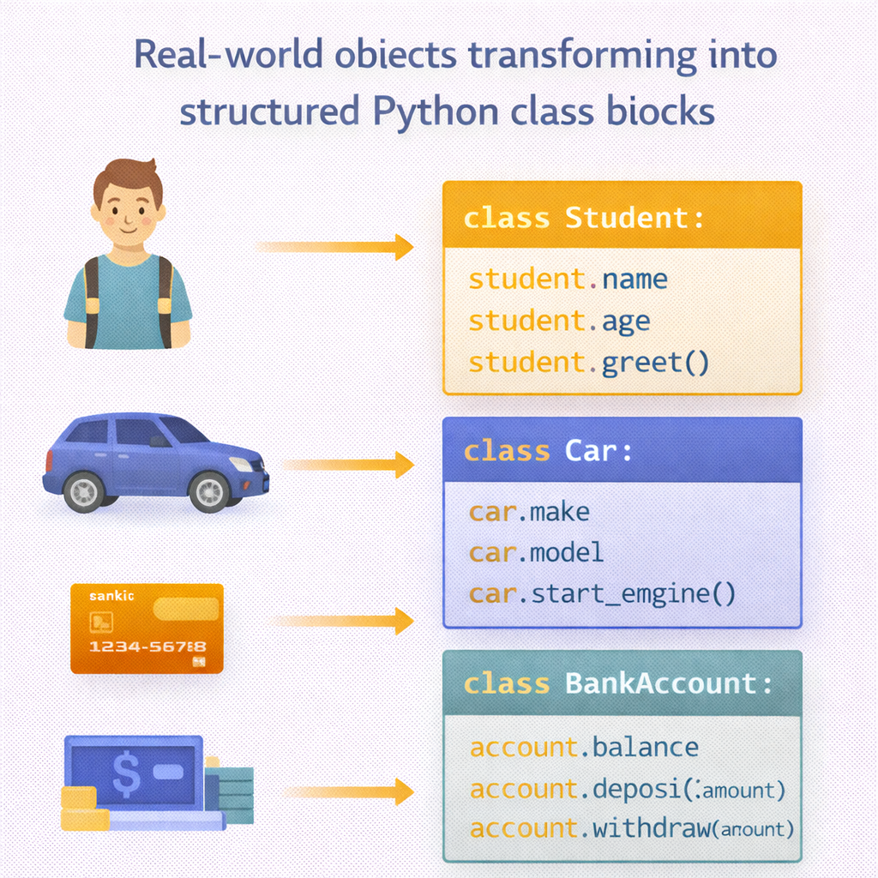

Slide 6
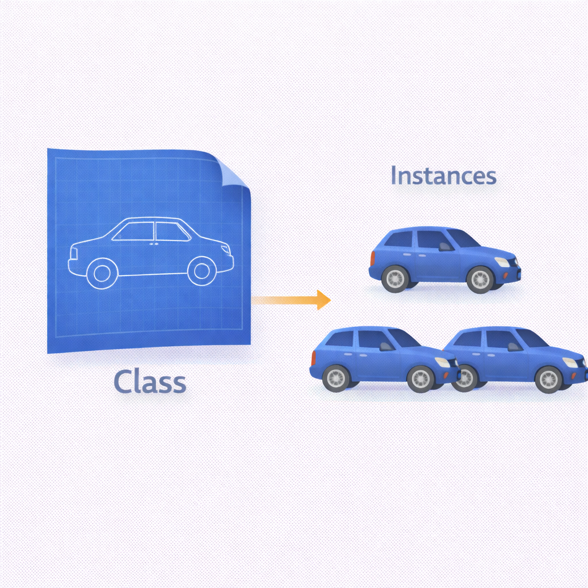
Classes vs Instances
A class is a blueprint; an instance is an actual object created from it.
Class defines structure and rules
Instance is a real object in memory
One class → many instances
Instances hold their own data
Methods are shared by all instances
Notes:
Reinforce: the class is not the object. Each instance has its own data, but shares behavior. This concept is essential before inheritance.

Slide 7
Example Python Code
class Car:
def __init__(self, brand, color):
self.brand = brand
self.color = color
car1 = Car("Toyota", "Red")
car2 = Car("Honda", "Blue")
print(car1.brand, car1.color)
print(car2.brand, car2.color)

Slide 8
Attribute Lookup
Python searches attributes in a specific order when you access them.
Instance attributes checked first
Then class attributes
Then parent class attributes
Same rule applies to methods
Understanding lookup avoids bugs
Image Prompt
Speaker Notes
Notes:
Explain why self.name overrides School.name. This helps students understand unexpected behavior later. Mention debugging benefits.

Slide 9
Example Python Code
class School:
name = "Sekolah ABC"
class Student(School):
def __init__(self, name):
self.name = name
s = Student("Aina")
print(s.name) # instance attribute
print(Student.name) # class attribute

Slide 10
Inheritance & Polymorphism
Inheritance reuses code; polymorphism allows flexible behavior.
Child class inherits from parent
Shared behavior lives in parent
Child can override methods
Same method name, different behavior
Enables scalable designs
Notes:
Highlight that the loop does not care about object type. Same interface (speak()), different behavior. This is the core power of polymorphism.

Slide 11
Example Python Code
class Animal:
def speak(self):
print("The animal makes a sound")
class Dog(Animal):
def speak(self):
print("Dog barks")
class Cat(Animal):
def speak(self):
print("Cat meows")
animals = [Dog(), Cat()]
for animal in animals:
animal.speak()

Slide 12
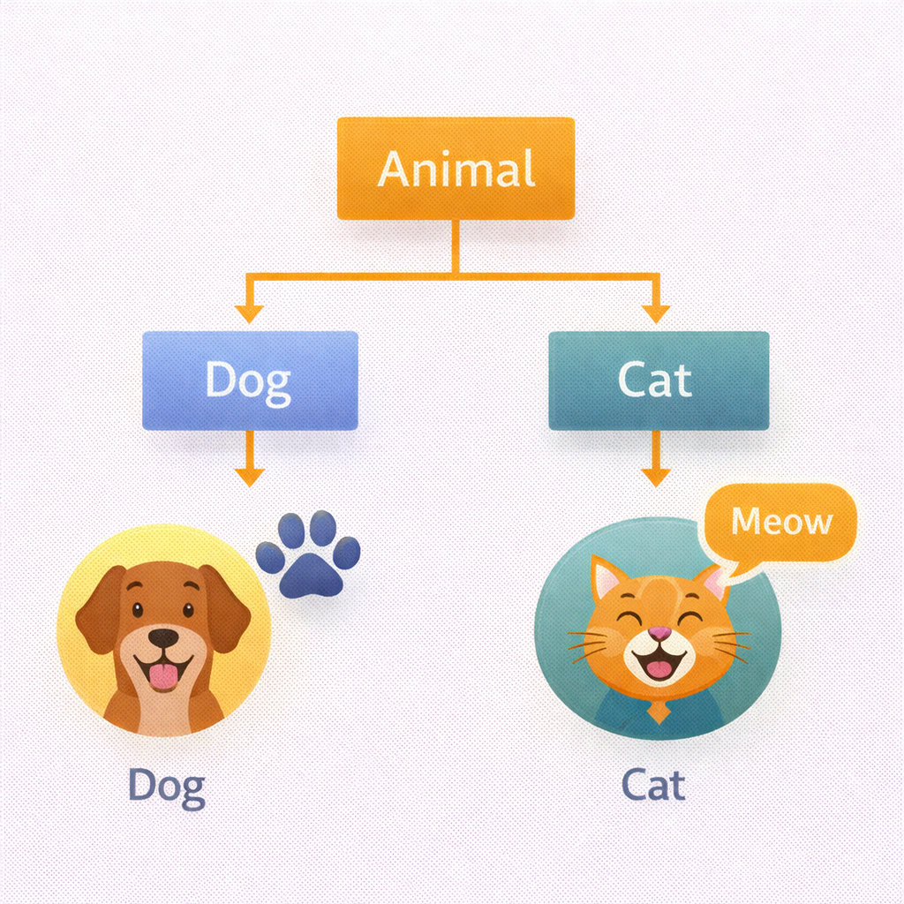

Slide 13
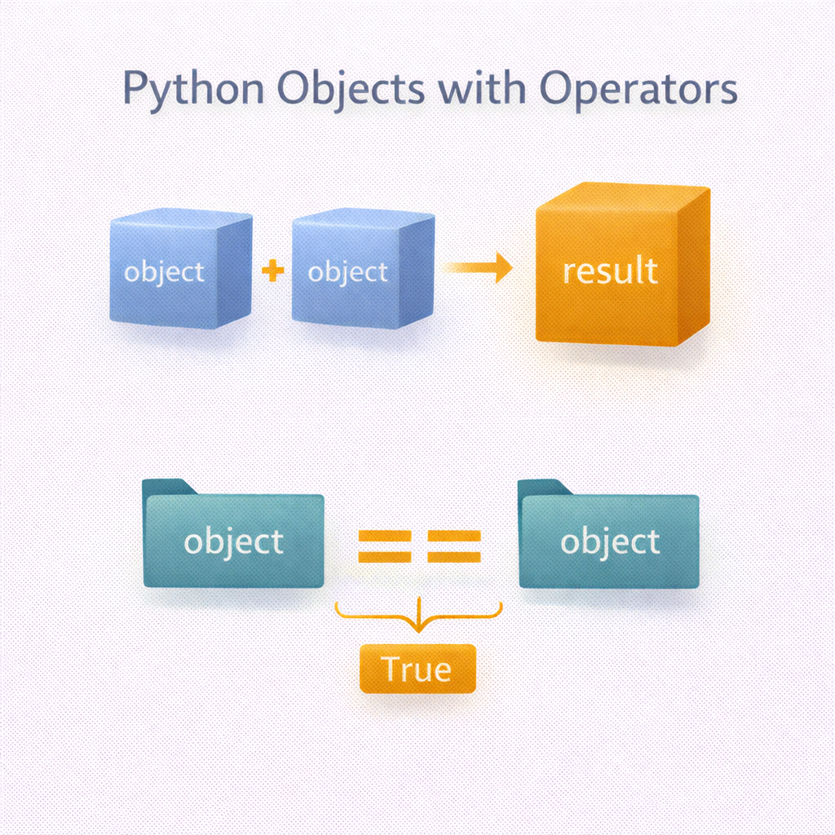
Operator Overloading Concepts
Operator overloading lets custom objects behave like built-in types.
Operators map to special methods
Improves readability of domain logic
Makes custom objects feel natural
Common in math and finance models
Must be used consistently
Notes:
Explain that + is actually calling __add__. Show how this improves readability compared to method calls. Warn against overusing operator overloading.

Slide 14
Example Python Code
class Point:
def __init__(self, x, y):
self.x = x
self.y = y
def __add__(self, other):
return Point(self.x + other.x, self.y + other.y)
p1 = Point(2, 3)
p2 = Point(4, 5)
p3 = p1 + p2
print(p3.x, p3.y)

Slide 15
Key Takeaways
Classes structure programs
Instances represent real objects
Attribute lookup follows a clear order
Inheritance + polymorphism enable reuse
Operator overloading improves expressiveness

